Slide 1

Project Grace
By the Power of Grace God, I have the Power

Slide 2
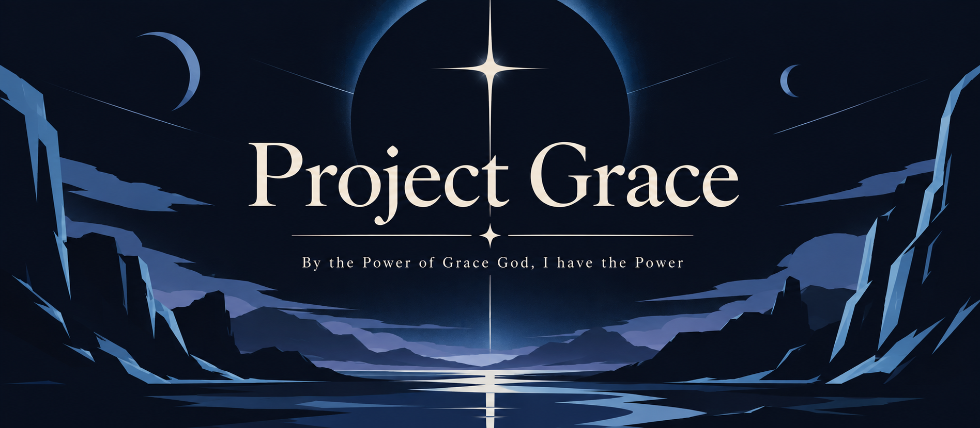

Slide 3


Slide 4


